Slide 1
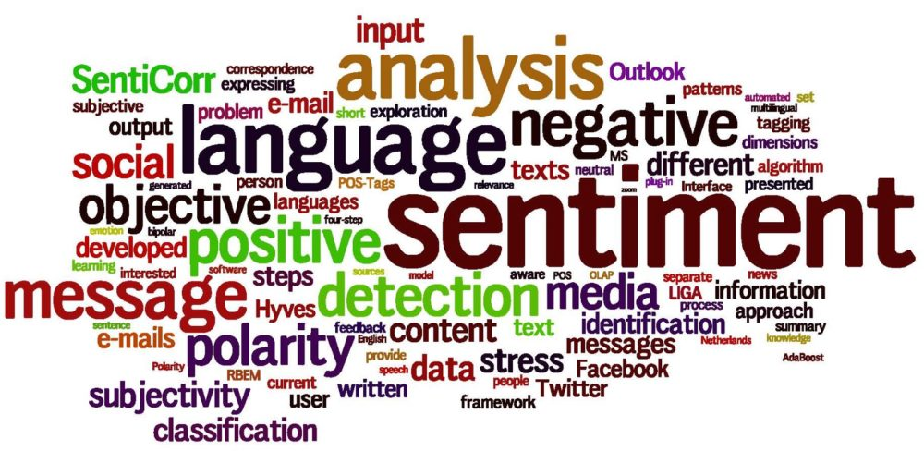


SENTIMENT ANALYSIS OF RESTAURANT REVIEW
Presentation By:
KARTHIK BR
Computer Science Engineering
karthikbrinfopro@gmail.com
CAMBRIDGE INSTITUTE OF TECHNOLOGY
Banglore , Karnataka .
Artificial Intelligence internship (AUG - OCT 2023)

Slide 2
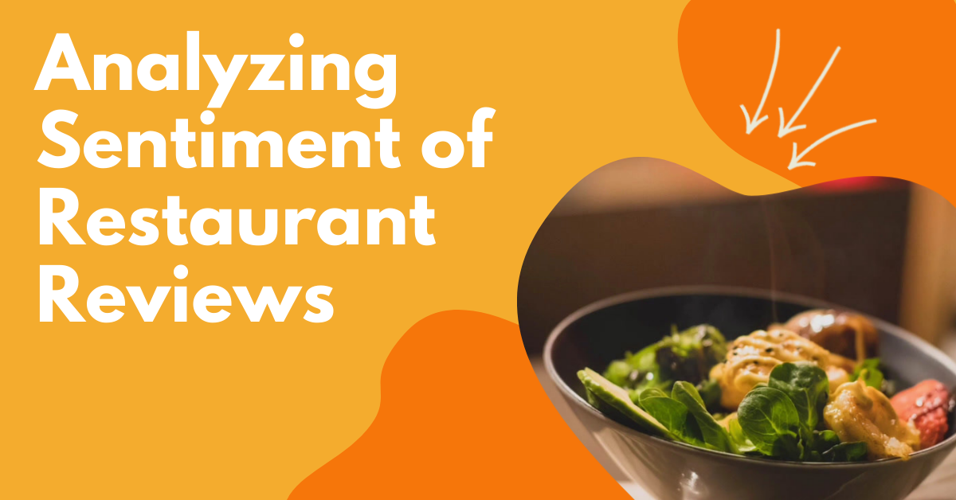

Artificial intelligence - IBM

Slide 3

PROBLEM STATEMENT :
Objective: To analyze the sentiment expressed in restaurant reviews to understand customer satisfaction.
Scope: This project focuses on collecting and analyzing customer reviews of restaurants to determine whether the sentiment in the reviews is positive, negative, or neutral.
Significance: The project is significant because it can help restaurant owners and managers gauge customer satisfaction, identify areas for improvement, and make data-driven decisions to enhance their services.
Artificial intelligence - IBM

Slide 4

Agenda:
I. Introduction
Project Overview
End users
II. Data Preparation
Solution and value
Data Collection and Cleaning
III. Sentiment Analysis Models
Model Selection and Training and technique
IV. Snap shots
Model Performance Metrics
Accuracy graph and charts
V. RESULTS
PRIDICTION & ANALYSIS
LINKS.
Artificial intelligence - IBM

Slide 5
PROJECT OVERVIEW
The "Sentiment Analysis of Restaurant Reviews" project is designed to leverage Natural Language Processing (NLP) and machine learning techniques to extract valuable insights from customer reviews of restaurants. By analyzing the sentiment expressed in these reviews, we aim to help restaurant owners and managers better understand customer satisfaction, identify areas for improvement, and make data-driven decisions to enhance their services.
Scope:
This project will focus on the analysis of restaurant reviews gathered from popular online review platforms such as Yelp, TripAdvisor, and Google Reviews. The sentiment analysis model will be developed using state-of-the-art NLP techniques and machine learning algorithms. The project will not involve sentiment analysis of other types of text data beyond restaurant reviews.
Objectives:
Develop a sentiment analysis model capable of categorizing restaurant reviews into positive, negative, or neutral sentiments.
Gather and preprocess a large dataset of restaurant reviews from various online sources.
Artificial intelligence - IBM
Department of Computer Science & Engineering
www.cambridge.edu.in

Slide 6

Who are the “END USER”:
Primary End Users:
Restaurant Owners and Managers:
Identify specific areas for improvement based on customer feedback.
Track performance over time and respond to emerging trends.
Secondary End Users:
Customers:
Indirectly benefit from improved restaurant experiences as a result of the feedback-driven enhancements.
May have access to aggregated restaurant sentiment data for making informed dining choices.
Marketing Teams
Investors and Stakeholders
Food Critics and Bloggers
Regulatory Authorities
Artificial intelligence - IBM

Slide 7

SOLUTION AND THE VALUE PROPOSITION:
Solution Overview:
Sentiment Analysis Model: We have developed a sophisticated sentiment analysis model using state-of-the-art NLP techniques and machine learning algorithms.
Data Collection Pipeline: We gather and preprocess a diverse dataset of restaurant reviews from multiple online sources.
User-Friendly Dashboard: Our platform offers an intuitive dashboard for easy access to sentiment analysis results.
Value Proposition:
Accurate Sentiment Analysis
Real-time Monitoring
Actionable Insights
Competitive Advantage
Time and Cost Savings
Artificial intelligence - IBM

Slide 8
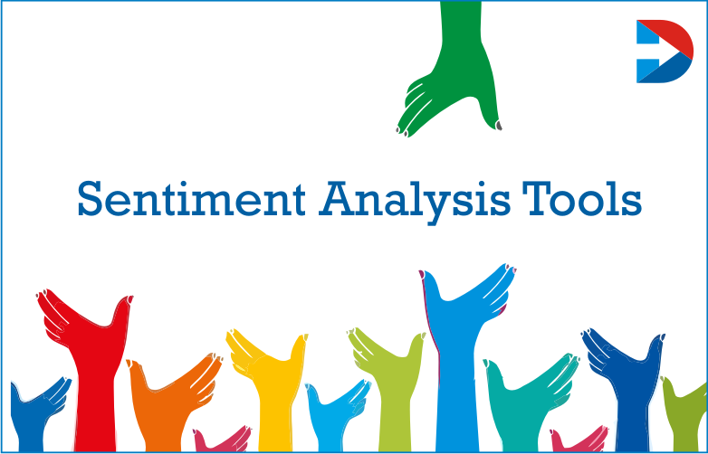
Customization and Unique Solution:
Customization Process:
Carefully selected diverse data sources.
Fine-tuned the sentiment analysis model.
Customized the user-friendly dashboard.
Unique Features of Our Solution:
Industry-specific expertise.
Consideration of regional and local context.
Scalability for various restaurant sizes.
Establishment of a feedback loop for ongoing improvements.
Benefits of Our Customization:
Higher accuracy in sentiment analysis.
Relevance to the restaurant industry.
Competitive advantage for restaurants.
Efficiency in data processing and analysis.
Artificial intelligence - IBM

Slide 9
MODELLING TECHNIQUE:
Supervised Learning: We used supervised learning with labeled data (positive, negative, neutral).
Key Techniques: Employed NLP for text Preprocessing, feature engineering, and multiple sentiment analysis models:
Multinomial Naive Bayes
Bernoulli Naive Bayes
Logistic Regression
Fine-Tuning: Extensive Hyperparameter tuning and regularization techniques to optimize model performance.
Handling Imbalanced Data: Addressed imbalanced datasets using various techniques.
Model Evaluation: Assessed performance using standard metrics and cross-validation.
Interpretable Results: Developed techniques for interpreting model predictions.
Scalability: Our approach is designed for scalability to handle large volumes of restaurant reviews.
Ethical Considerations: Emphasized ethical practices for fairness and transparency.
Artificial intelligence - IBM

Slide 10
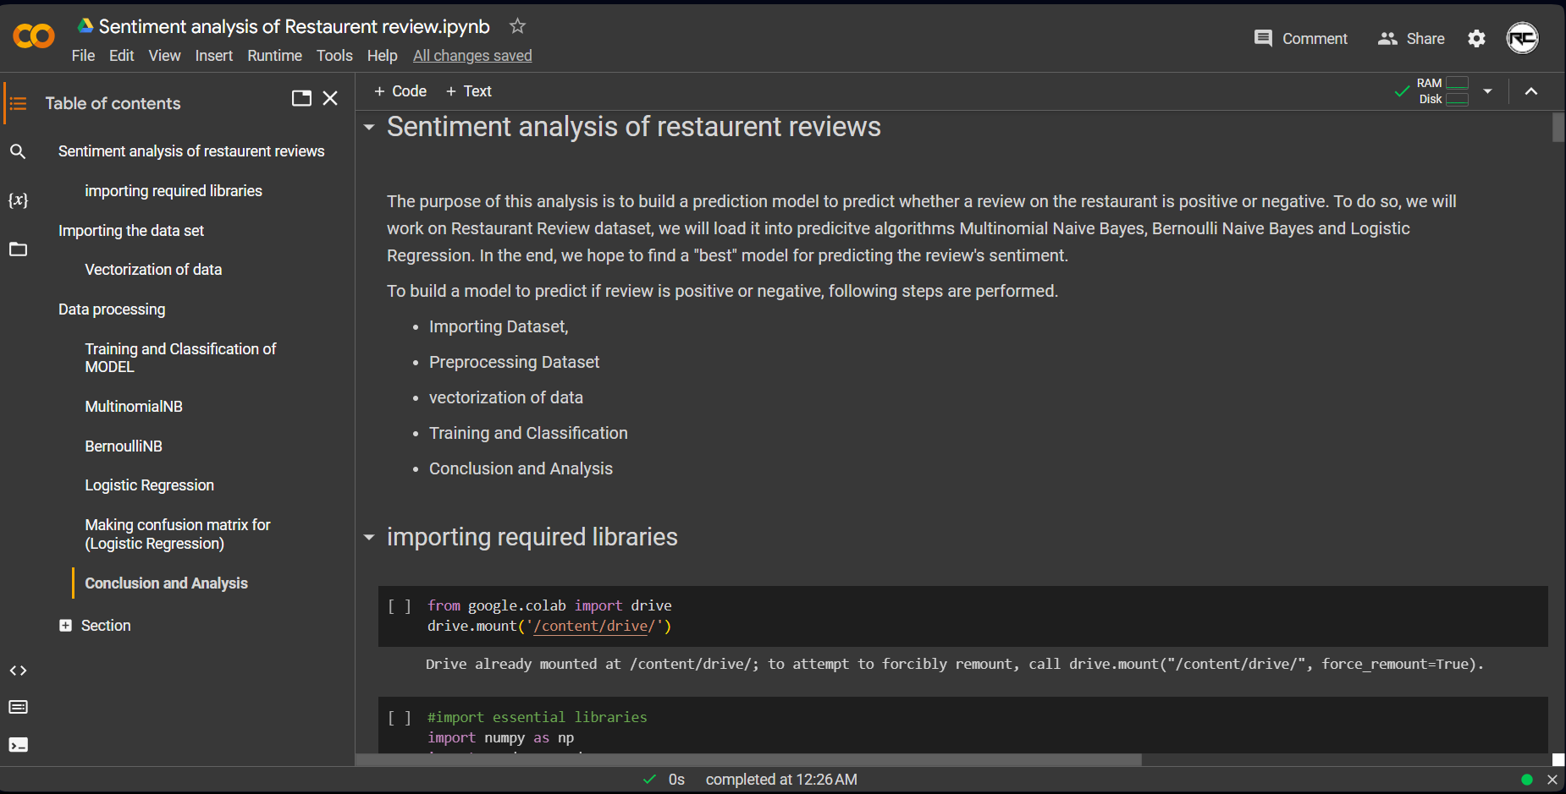
Snapshots:
1
Artificial intelligence - IBM

Slide 11
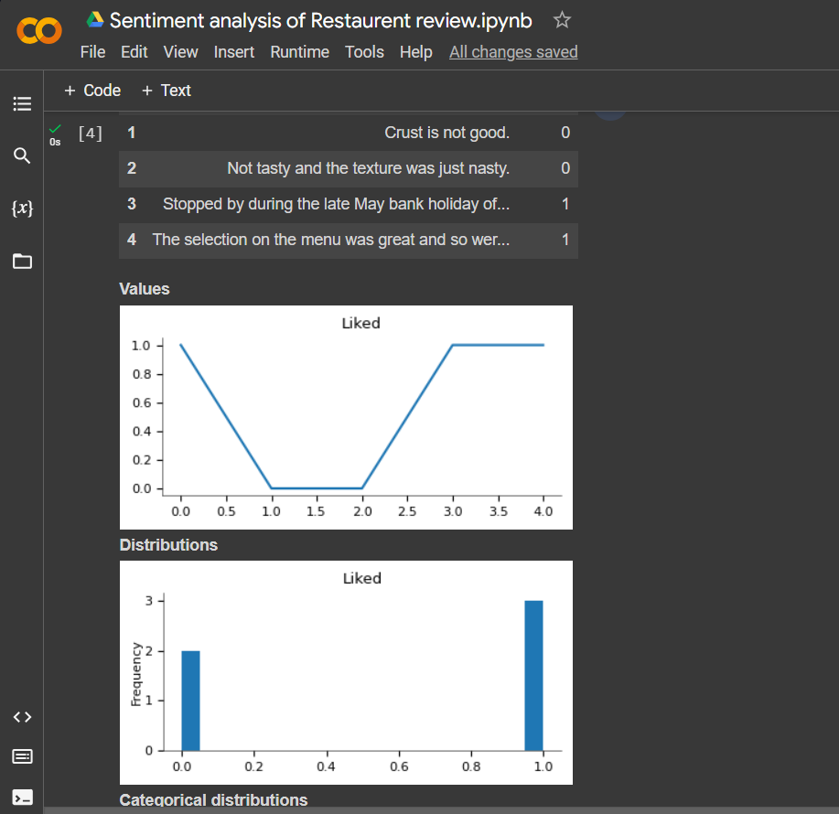
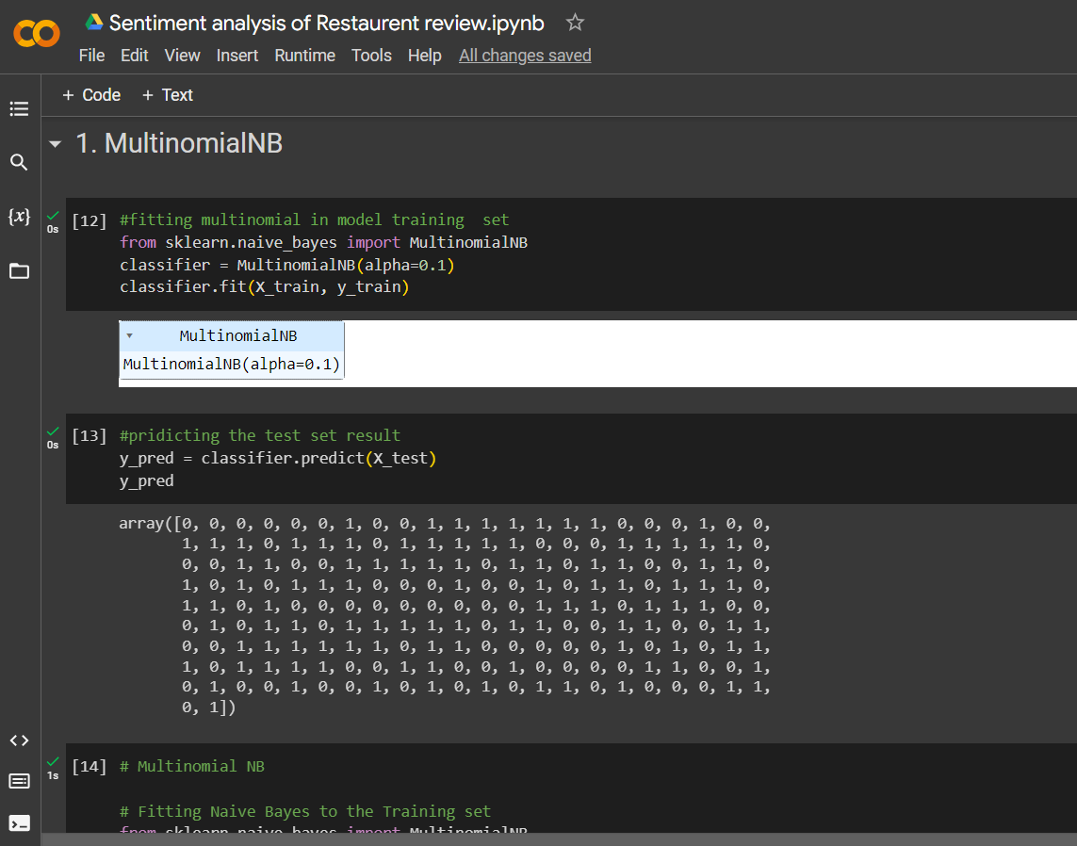
2.
Artificial intelligence - IBM

Slide 12
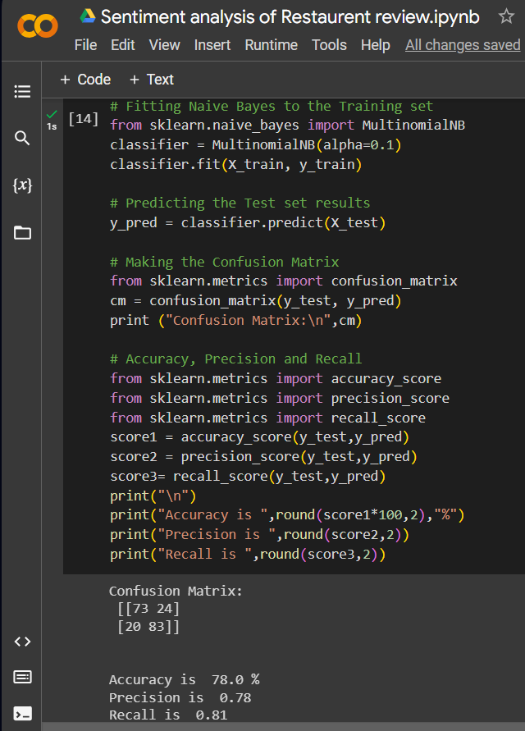
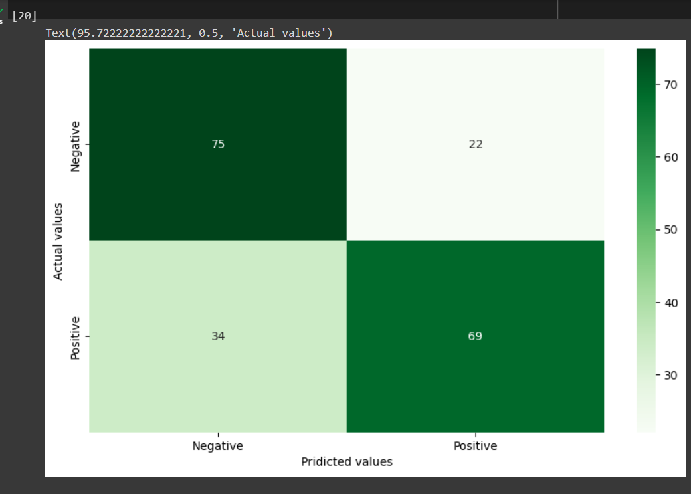
3.
Artificial intelligence - IBM

Slide 13
4.
Artificial intelligence - IBM

Slide 14
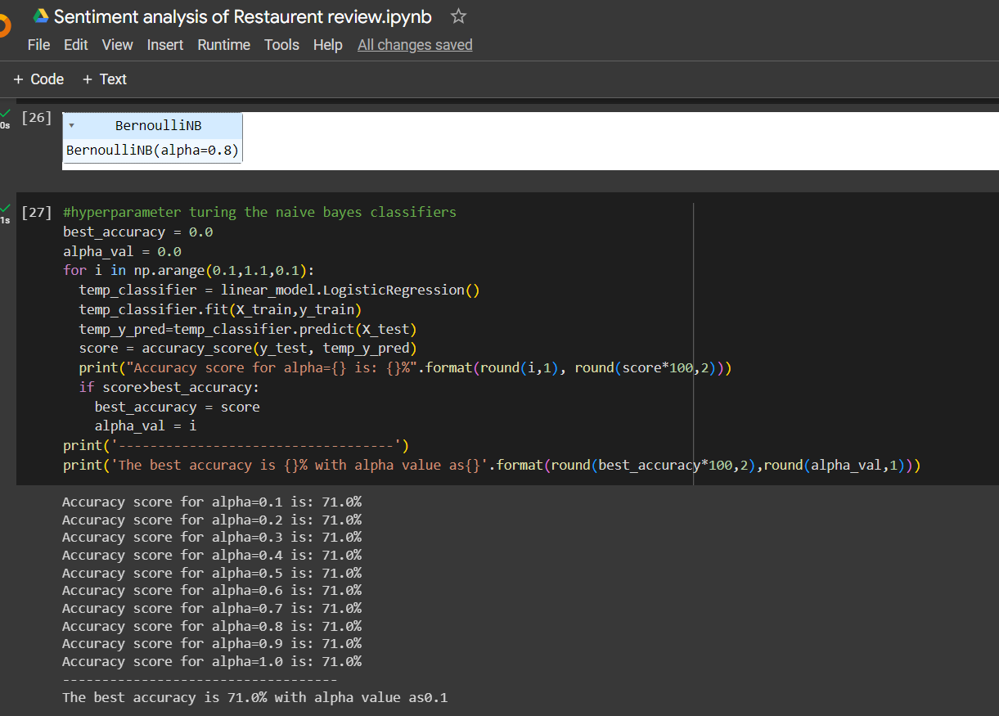
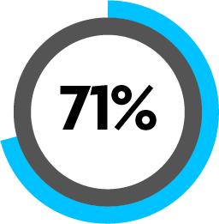
5.
Artificial intelligence - IBM

Slide 15

Results:
Sentiment Distribution:
Visual representation of sentiment distribution across restaurant reviews.
Percentage breakdown of positive, negative, and neutral sentiments.
Performance Metrics:
Accuracy: [78.2%]
Precision: [0.8]
Recall: [0.7-0.9]
F1-Score: [F1=2⋅Precision+RecallPrecision⋅Recall​]
ROC-AUC: 0.5-1.0
Key Findings: Positive & Negative
Artificial intelligence - IBM

Slide 16
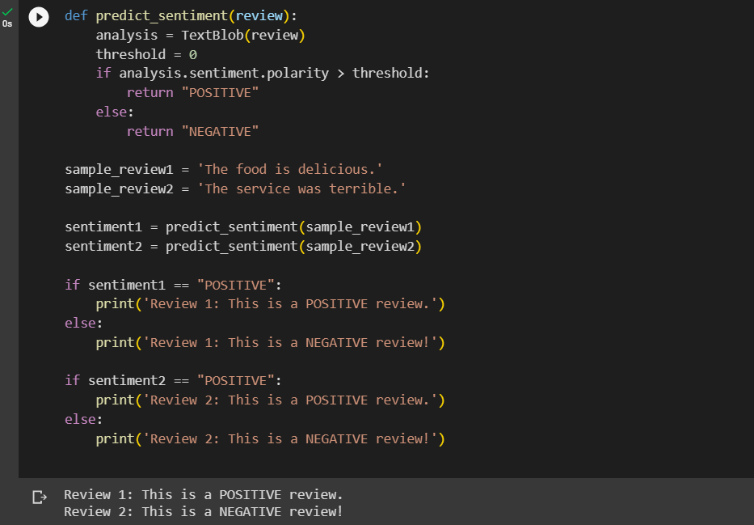
pridictions & Analysis:
P+
N-
pridict
results
Artificial intelligence - IBM

Slide 17
LINKS:
THE PROJECT LINKS:
https://www.kaggle.com/code/apekshakom/sentiment-analysis-of-restaurant-reviews
https://colab.research.google.com/drive/1jRc703higlf4SCG7haitmhTrO8Z29u-O?usp=sharing
ACADAMIC JOURNALS:
https://www.irjmets.com/uploadedfiles/paper/volume3/issue_4_april_2021/9088/1628083371.pdf
ONLINE LEARNING PLATFORMS:
https://www.geeksforgeeks.org/what-is-sentiment-analysis/
Artificial intelligence - IBM

Slide 18
Gracious!
Artificial intelligence - IBM

